Slide 1
Lending Club Case Study SUBMISSION
Group Name: One Hit Wonders
Chandana G
Karthik s.k.
Sheshanth As
Vikram Singh Chouhan

Slide 2
Lending Club Case Study Strategy
Business objective and strategy:
The objective is to identify the driving factors (or driver variables) behind loan default, i.e. the variables which are strong indicators of default. The company can utilize this knowledge for its portfolio and risk assessment.
Business and Data Understanding :
Company is the largest online loan marketplace, facilitating personal loans, business loans, and financing of medical procedures. Borrowers can easily access lower interest rate loans through a fast online interface.
lending companies, lending loans to ‘risky’ applicants is the largest source of financial loss (called credit loss). The credit loss is the amount of money lost by the lender when the borrower refuses to pay or runs away with the money owed. We can say that borrowers who default cause the largest amount of loss to the lenders. In this case, the customers labelled as 'charged-off' are the 'defaulters’.
If we able to identify these risky loan applicants, then such loans can be reduced thereby cutting down the amount of credit loss. Identification of such applicants using EDA is the aim of this case study.
The company wants to understand the driving factors (or driver variables) behind loan default, i.e. the variables which are strong indicators of default. So that company can utilize this details to manage their portfolio and risk management.
How Lending Club Works :
1. Borrower Apply for loan ,investor open account
2. Borrower get founded and investor build a portfolio
3. Borrower repay automatically and Investor earn & reinvest
Available data :
1.Loan Dataset.
2. Data Dictionary.

Slide 3
Lending Club Case Study Strategy
Business Understanding :
As a consumer finance company which lending various types of loans to urban customers. When the company receives a loan application, the company has to make a decision for loan approval based on the applicant’s profile. Two types of risks are associated with the bank’s decision:
If the applicant is likely to repay the loan, then not approving the loan results in a loss of business to the company
If the applicant is not likely to repay the loan, i.e. he/she is likely to default, then approving the loan may lead to a financial loss for the company
The data given below contains the information about past loan applicants and whether they ‘defaulted’ or not. The aim is to identify patterns which indicate if a person is likely to default, which may be used for taking actions such as denying the loan, reducing the amount of loan, lending (to risky applicants) at a higher interest rate, etc.
Business Decisions Taken By company :
there are two types of decisions that could be taken by the company:
Loan accepted: If the company approves the loan, there are 3 possible scenarios described below:
Fully paid: Applicant has fully paid the loan (the principal and the interest rate)
Current: Applicant is in the process of paying the instalments, i.e. the tenure of the loan is not yet completed. These candidates are not labelled as 'defaulted'.
Charged-off: Applicant has not paid the instalments in due time for a long period of time, i.e. he/she has defaulted on the loan
Loan rejected: The company had rejected the loan (because the candidate does not meet their requirements etc.). Since the loan was rejected, there is no transactional history of those applicants with the company and so this data is not available with the company (and thus in this dataset)

Slide 4
Problem solving methodology
flow chart
Understanding Lending Club
investment strategy
Using Python programming tool for EDA
Data Collection and Analyzing
Plot Presentation
#Year vs total amount issue
# Loan Status,loan duration, loan amount, default count,
default Estate
Find Company
Lending details , consumer attributes and loan attributes
With help of dictionary dataset
Lending Analysis by identifying driving factors (or driver variables) behind loan default maximum loan disburse year,max chargeoff cases in year
Find out Loan Status approve cases, Fully paid, charge off, Current with Loan Amount , duration and Address State
Data Cleaning removing NaN values, outliers if any

Slide 5
Data Analysis
Loan Data Set ;
No of Column are 111 and Rows are 39718
Out of 111 Columns 52 Columns have values and rest 59 having NaN and zero value.
Understand what minimum to maximum amount issued to borrowers.
Understand what amount used Mostly issued to borrowers
Which year issued the most loans.
The distribution of loan amounts is a multinomial distribution .
Summary :
Most of the loans issued were in the range of 500 to 35,000 USD.
Most of the loans issued to borrowers are 10000 and 12000 USD
The year of 2011 was the year were most loans were issued.
Loans were issued in an incremental manner.
The loans applied by potential borrowers, the amount issued to the borrowers and the amount funded by investors are similarly distributed, meaning that it is most likely that qualified borrowers are going to get the loan they had applied for.

Slide 6
Data Analysis
Types of Loans:
Good Loans vs Bad Loans
The amount of bad loans could increment as the days pass by, since we still have a great amount of current loans.
Average annual income is an important key metric for finding possible opportunities of investments in a specific region.
Loans Issued by Region :
Here we want to analyze loans issued by region in order to see region patters that will allow us to understand which region gives Lending Club.
The Business Perspective understanding the Operative Side of Business :
What we need to know:
We will focus on three key metrics: Loans issued by state (Total Sum), Average interest rates charged to customers and average annual income of all customers by state.
The purpose of this analysis is to see states that give high returns at a descent risk.
Analysis by Income Category:
In this section we will create different income categories in order to detect important patters and go more into depth in our analysis.
What we need to know:
Low income category: Borrowers that have an annual income lower or equal to 100,000 usd.
Medium income category: Borrowers that have an annual income higher than 100,000 usd but lower or equal to 200,000 usd.
High income category: Borrowers that have an annual income higher tha 200,000 usd.

Slide 7
Data Analysis
Understanding the Risky side of Business :
Although the operative side of business is important, we have to also analyze the level of risk in each state. Credit scores are important metrics to analyze the level of risk of an individual customer. However, there are also other important metrics to somehow estimate the level of risk of other states.
Debt-to-income is an important metric since it says approximately the level of debt of each individual consumer with respect to its total income.
The average length of employment tells us a better story about the labor market in each state which is helpful to assess the level of risk.
The Importance of Credit Scores:
Credit scores are important metrics for assessing the overall level of risk. In this section we will analyze the level of risk as a whole and how many loans were bad loans by the type of grade received in the credit score of the customer.
The lower the grade of the credit score, the higher the risk for investors.
There are different factors that influence on the level of risk of the loan.

Slide 8
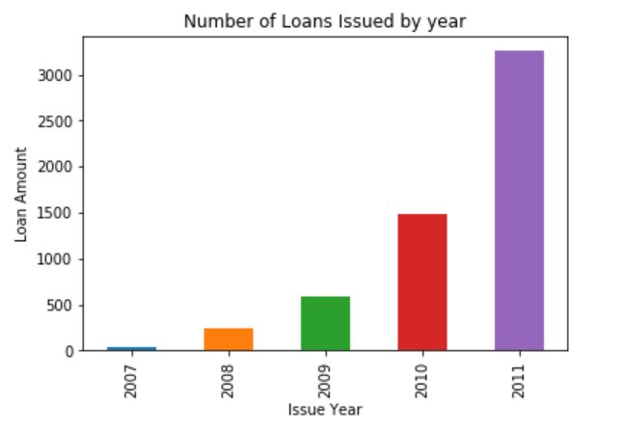
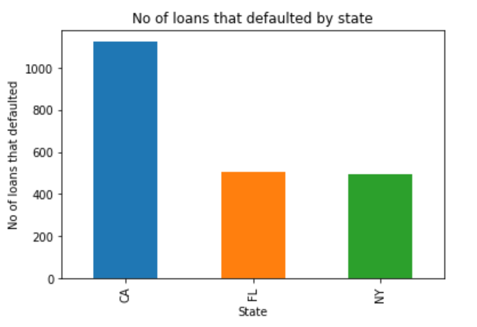
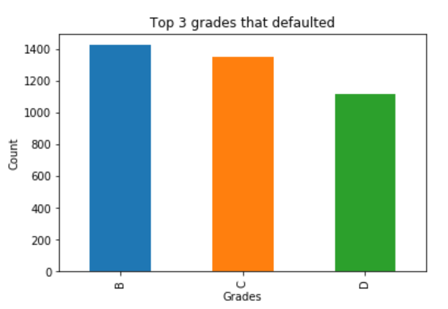
Data Analysis
The total number of loans issue that defaulted was in the year 2011, and most of the loans that were issued were for the purpose of debt consolidation, other purposes and credit repayment
Most of the loans that defaulted fall under Grade B, Grade C and Grade D
Most number of loans that defaulted were in the states CA, FL and NY

Slide 9
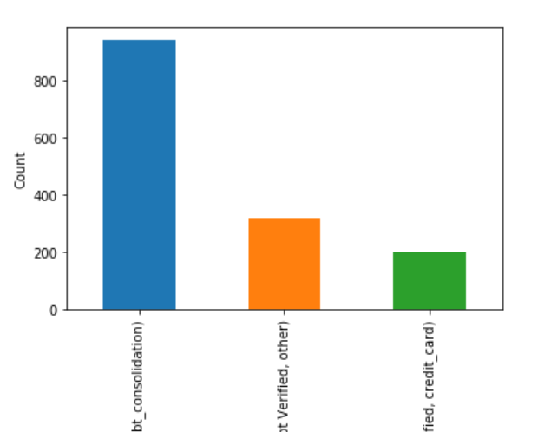
Loan Accepted Terms and Scenarios verification status
It is also seen that, for the most common reason for which the loans were defaulted, the verification of annual income was not done

Slide 10
Derogatory Public record and bankruptcies
A derogatory record is any negative information on your credit report that lowers your credit score. The record can be a minor issue like a few late payments or a more serious concern, such as bankruptcy
More than 467 individuals were reported in public derogatory record out of which 368 were bankrupt
The amount that was issued to bankrupt individuals was as high as 35,000$

Slide 11
It is found that more that 20% of the borrowers on MORTGAGE have applied for loan turned out to be defaulters and the amount applied was as high as 35,000$

Slide 12
Conclusions
Most of the loans that were defaulted was because of failure to verify the source of income
Another main reason I could see is the public derogatory records and bankruptcy, I found that around 367 individuals we bankrupt atleast once and 2 of them were bankrupt twice. Such mistakes should be strictly monitored
Maximum Loan disburse from borrower of states CA,NY,FL and maximum default cases also from this state and maximum non verified full paid amount also from these states,
Maximum Loan disburse in year of 2011 and loan disbursement comes as incremental manner every year from 2007 to 2011.
Lending Club Staff maximum loan applications accepted by Staff having Exp 10+ year and maximum charge off cases also observe under high experience staff
So to overcome default applications Lending club have to tighten there management in the process of Verifications before disburse full amount,
Need to check borrowers income and loan % Interest as per limit, maximum charge off cases come in between % interest 10-20 so need close eyes on these applications. Need to check higher experience staff disbursement strategy. Need to focus on the state where average income of people are higher than CA,NY and FL.

